Slide 1
Detecting Malicious Facebook Applications

Slide 2
ABSTRACT:
Our key contribution is in developing FRAppE—Facebook’s Rigorous Application Evaluator—arguably the first tool focused on detecting malicious apps on Facebook. Second, leveraging these distinguishing features, we show that FRAppE can detect malicious apps with 99.5% accuracy, with no false positives and a high true positive rate (95.9%). Finally, we explore the ecosystem of malicious Facebook apps and identify mechanisms that these apps use to propagate.

Slide 3
EXISTING SYSTEM:
So far, the research community has paid little attention to OSN apps specifically. Most research related to spam and malware on Facebook has focused on detecting malicious posts and social spam campaigns.
Gao et al. analyzed posts on the walls of 3.5 million Facebook users and showed that 10% of links posted on Facebook walls are spam. They also presented techniques to identify compromised accounts and spam campaigns.

Slide 4
DISADVANTAGES OF EXISTING SYSTEM:
Existing system works concentrated only on classifying individual URLs or posts as spam, but not focused on identifying malicious applications that are the main source of spam on Facebook.
Existing system works focused on accounts created by spammers instead of malicious application.

Slide 5
PROPOSED SYSTEM:
In this paper, we develop FRAppE, a suite of efficient classification techniques for identifying whether an app is malicious or not. To build FRAppE, we use data from MyPage- Keeper, a security app in Facebook.
We find that malicious applications significantly differ from benign applications with respect to two classes of features: On-Demand Features and Aggregation-Based Features.

Slide 6
ADVANTAGES OF PROPOSED SYSTEM:
The proposed work is arguably the first comprehensive study focusing on malicious Facebook apps that focuses on quantifying, profiling, and understanding malicious apps and synthesizes this information into an effective detection approach.
Several features used by FRAppE, such as the reputation of redirect URIs, the number of required permissions, and the use of different client IDs in app installation URLs, are robust to the evolution of hackers.

Slide 7
SYSTEM MODEL:

Slide 8
SYSTEM ARCHITECTURE:

Slide 9
MODULES:
Data collection
Feature extraction
Training
Classification & Detection

Slide 10
Data collection
The data collection component has two subcomponents: the collection of facebook apps with URLs and crawling for URL redirections. Whenever this component obtains a facebook app with a URL, it executes a crawling thread that follows all redirections of the URL and looks up the corresponding IP addresses. The crawling thread appends these retrieved URL and IP chains to the tweet information and pushes it into a queue.

Slide 11
Feature extraction
The feature extraction component has three subcomponents: grouping of identical domains, finding entry point URLs, and extracting feature vectors.
To classify a post, MyPageKeeper evaluates every embedded URL in the post. Our key novelty lies in considering only the social context (e.g., the text message in the post, and the number of Likes on it) for the classification of the URL and the related post. Furthermore, we use the fact that we are observing more than one user, which can help us detect an epidemic spread.

Slide 12
Training
The training component has two subcomponents: retrieval of account statuses and training of the classifier. Because we use an offline supervised learning algorithm, the feature vectors for training are relatively older than feature vectors for classification. To label the training vectors, we use the account status; URLs from suspended accounts are considered malicious whereas URLs from active accounts are considered benign. We periodically update our classifier using labeled training vectors.

Slide 13
Classification
The classification component executes our classifier using input feature vectors to classify suspicious URLs. When the classifier returns a number of malicious feature vectors, this component flags the corresponding URLs information as suspicious.

Slide 14
HARDWARE REQUIREMENTS:
System : Pentium IV 2.4 GHz.
Hard Disk : 40 GB.
Floppy Drive : 1.44 Mb.
Monitor : 15 VGA Colour.
Mouse : Logitech.
Ram : 512 Mb.

Slide 15
SOFTWARE REQUIREMENTS:
Operating system : Windows XP/7.
Coding Language : JAVA/J2EE
IDE : Netbeans 7.4
Database : MYSQL

Slide 16
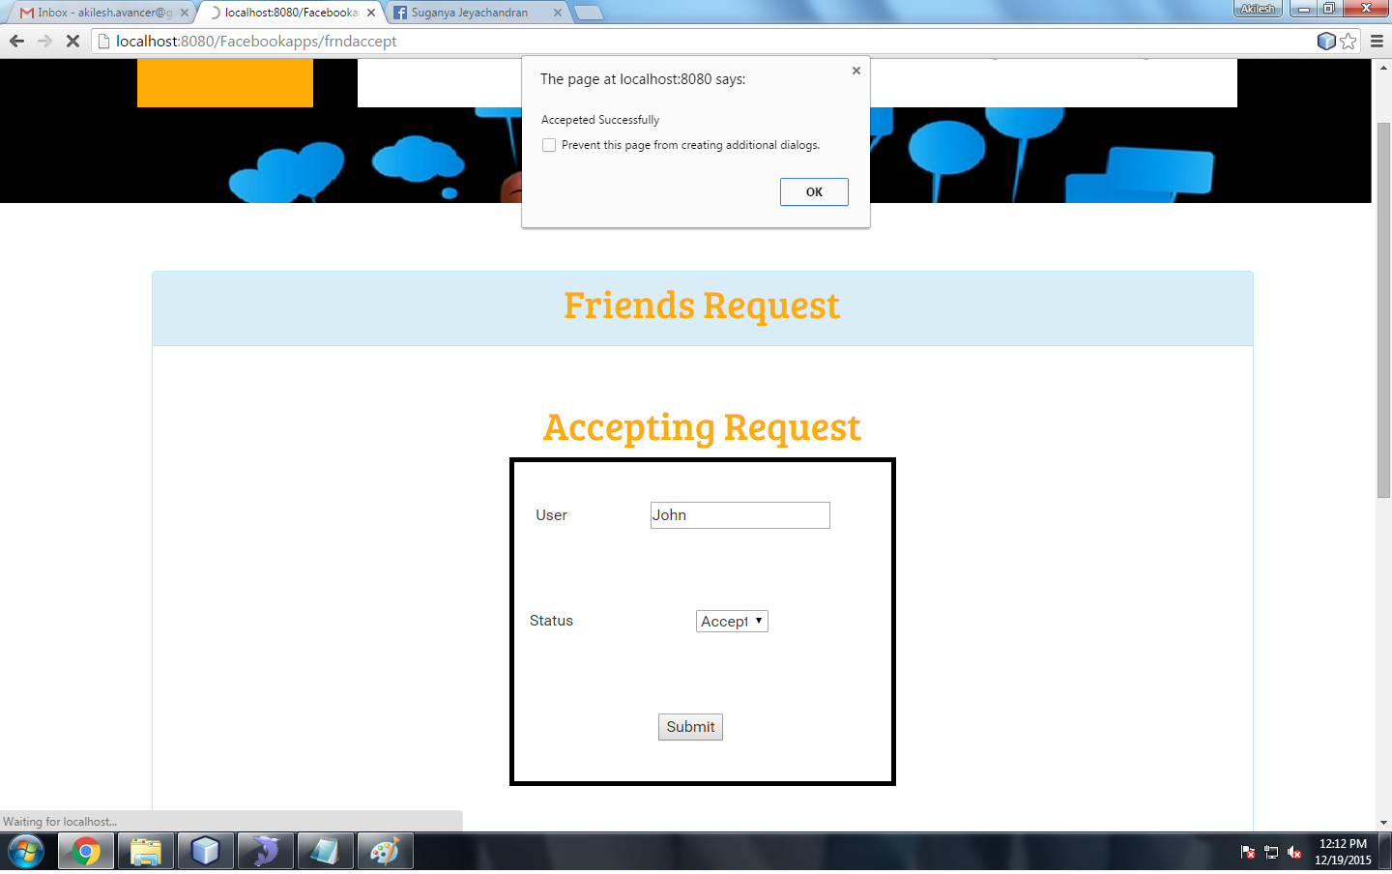

Slide 17
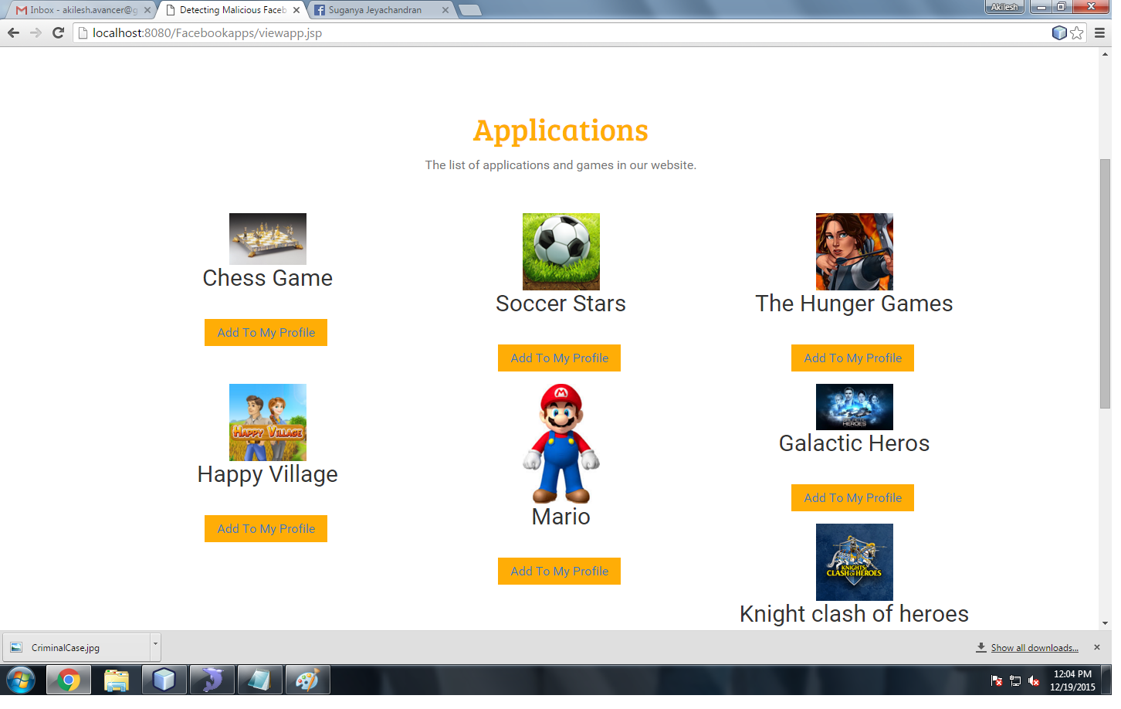

Slide 18
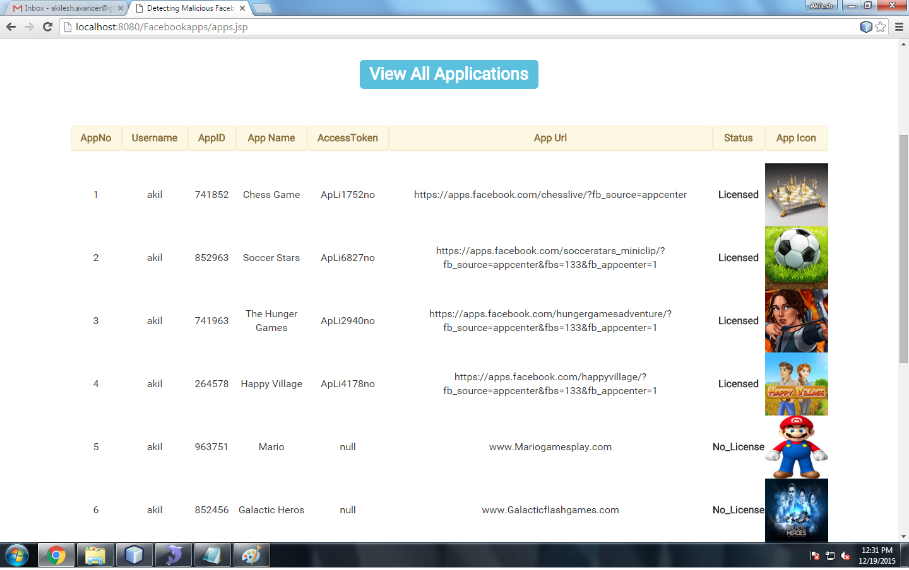

Slide 19
REFERENCE:
Sazzadur Rahman, Ting-Kai Huang, Harsha V. Madhyastha, and Michalis Faloutsos, “Detecting Malicious Facebook Applications”, IEEE/ACM TRANSACTIONS ON NETWORKING, VOL. 24, NO. 2, APRIL 2016.

